Slide 1
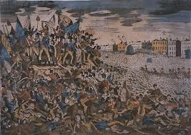
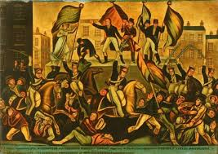
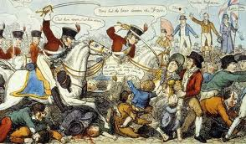
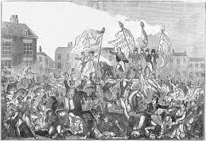
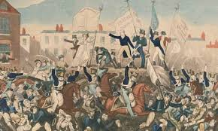
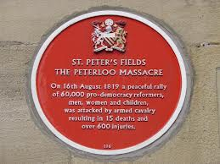
The Peterloo Massacre
By: Aneesh Gowri
Period 3 Kinberg

Slide 2
A Little Background
Habeas Corpus – stated that if the culprit’s detention cannot be legally justified, they must be released immediately. Adopted in Britain in 1679
All about the Habeas Corpus: http://www.legislation.gov.uk/aep/Cha2/31/2/contents
Corn Laws – British grain tariffs which raised the price of bread. This benefitted the gentry, but economically strained the middle and lower classes
More on the Corn Laws: http://www.historyhome.co.uk/peel/cornlaws/aclargue.htm

Slide 3
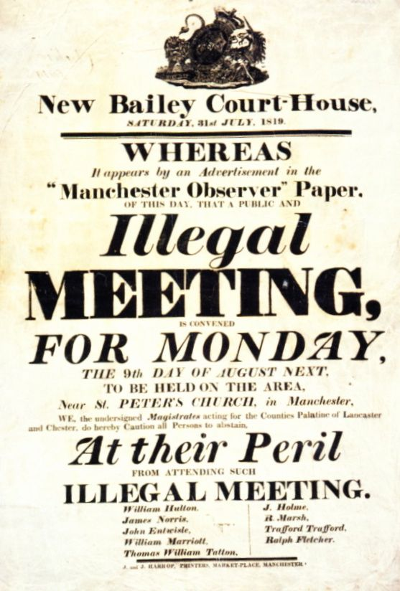
A Little Background
Date: August 9th, 1819 →
However, the government
protested, claiming that the
gathering was illegal, so the
protestors postponed it to
the 16th.

Slide 4
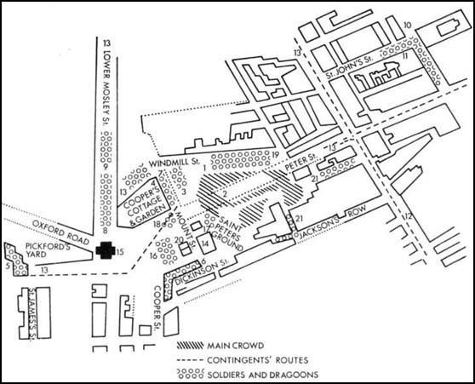
A Little Background
Location: St. Peter’s Field, Manchester, England

Slide 5
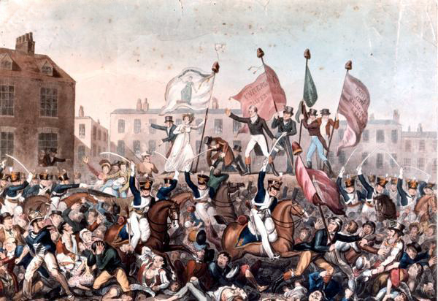
Who was there?
60,000 to 80,000 middle to lower class men, women, and children gathered at St. Peter’s Field to peacefully protest for universal suffrage, equal representation in parliament, and reform
Size of the Crowd at Peterloo

Slide 6
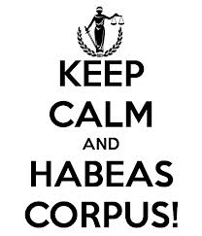
Reform What?
Well, the British people could not keep calm, Habeas Corpus had been suspended for the first time ever in 1817!

Slide 7
Reform What?
Only 3% of the population could vote (about 214,000 men)
Most men and no women could not vote or hold seats in parliament

Slide 8
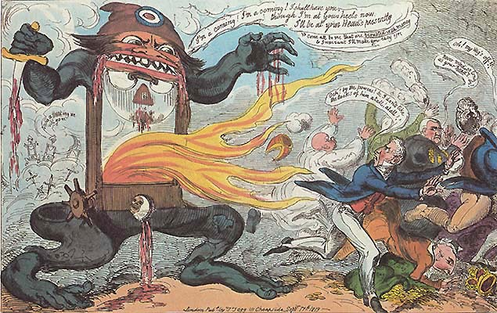
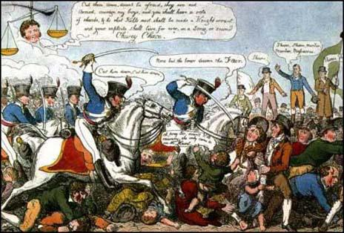
What Happened?
The Manchester Magistrates called the Yeomanry Cavalry to stop the protesting citizens
The Cavalry rode in, killing twelve and injuring seven hundred
Deaths at Peterloo
Interesting Link to Memorial Page

Slide 9
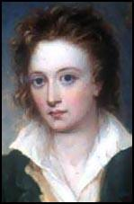
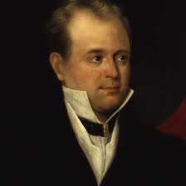
Reactions
The people were upset. Hundreds of their own were killed or injured simply for peacefully protesting
Richard Carlile's Reaction
John Tyas' Reaction
Percy Shelley's Poem:
The Mask of Anarchy

Slide 10
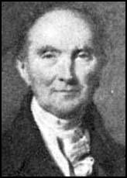
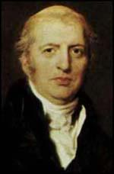
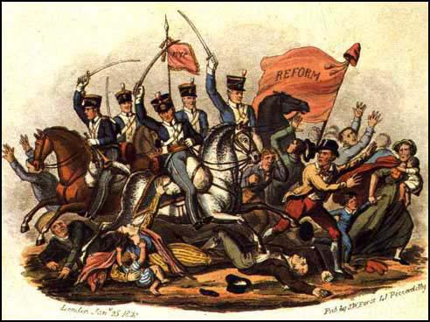
Reactions
But the government tried to justify their actions
They claimed that the magistrates were forced to act in the way that they did
Lord Liverpool's Reaction
Lord Sidmouth's Reaction

Slide 11
Why Should We Care?
Reform Bill of 1832: 800,000 men could vote. Parliamentary seats were more equally distributed (Big cities like Manchester were allowed more representatives than small towns). Also a national standard of currency was put in place
Reactions to the Refrom Bill
The Corn Laws were repealed!
Made way for Chartism!

Slide 12
Works Cited
"The Age of George III." The Peterloo Massacre, 16 August 1819: Primary Sources. N.p., n.d. Web. 09 Mar. 2014.
The Editors of Encyclopædia Britannica. "Corn Law (British History)." Encyclopedia Britannica Online. Encyclopedia Britannica, n.d. Web. 17 Mar. 2014.
"Glogster Home Page." Glogster. N.p., n.d. Web. 19 Mar. 2014.
"Habeas Corpus Rights: United Kingdom." Library of Congress Home. N.p., n.d. Web. 19 Mar. 2014.

Slide 13
Works Cited
"The National Archives | Exhibitions | Citizenship | Struggle for Democracy." The National Archives | Exhibitions | Citizenship | Struggle for Democracy. N.p., n.d. Web. 17 Mar. 2014.
"Peterloo Massacre." Spartacus Educational. N.p., n.d. Web. 17 Mar. 2014.
"The Peterloo Massacre Memorial Campaign." The Peterloo Massacre Memorial Campaign. N.p., n.d. Web. 09 Mar. 2014.
"Ruth's Adventures In Research." Ruths Adventures In Research. N.p., n.d. Web. 17 Mar. 2014.
"Spartacus Educational." Peterloo Massacre Index. N.p., n.d. Web. 17 Mar. 2014.

